Slide 1
Network Management Overview

Slide 2
5:25- 6:50 MW-S110
Anna Rhodora Mercado-Quitaleg
oliangelanne@yahoo.com
Edmodo Group Code:

Slide 3
Introduction
Network, associated resources and distributed applications indispensable
Complex systems
More things can go wrong
Requires automated network management tools
Need comprehensive data gathering and control tools
SNMP

Slide 4
Elements of Network Management
Fault
Accounting
Configuration
Performance
Security

Slide 5
Fault Management Overview
When fault occurs
Determine where
Isolate rest of network so it can continue to function
Reconfigure or modify network to minimize impact of operation without failed components
Repair or replace failed components
Fault is abnormal condition that requires action to repair
Errors (e.g. single bit error on line) occur and are not faults

Slide 6
Fault Management User Requirements
Fast and reliable problem resolution
Immediate notification
Impact and duration minimized by redundant components and routes
Fault tolerance
Fault management capability should be redundant
After correction, fault management must ensure problem is truly resolved and no new problems introduced
Problem tracking and control
Minimal effect on network performance

Slide 7
Accounting Management Overview
Individual cost centers or projects charged for use of network services
Network manager needs to be able to track use of network
User or group may be abusing access
Users may be making inefficient use of network
Need to plan for network growth

Slide 8
Accounting Management User Requirements
Needs to specify sort of accounting information recorded at various nodes
Interval between successive sendings of information
Algorithms used in calculating charges
Accounting reports under network manager control
Verify users' authorization to access and manipulate accounting information

Slide 9
Configuration and Name Management Overview
Choose appropriate software and attributes and values (e.g., a transport layer retransmission timer) for device depending on function(s)
Initializing network and gracefully shutting down
Maintaining, adding, and updating relationships among components
Status of components during network operation

Slide 10
Configuration and Name Management User Requirements
Startup and shutdown
Unattended
Need to identify components of network and connectivity
Define and modify default attributes
Load predefined attributes
Change connectivity
Reconfiguration
Status information and notification of changes
Routine or request driven reports
Authorized users (operators) only to manage and control operation (e.g., software distribution and updating)

Slide 11
Performance Management Overview
Monitoring
Tracks activities
What is the level of capacity utilization?
Is there excessive traffic?
Has throughput been reduced to unacceptable levels?
Are there bottlenecks?
Is response time increasing?
Controlling
Make adjustments to improve performance
Identify resources to be monitored
Metrics and values for resources

Slide 12
Performance Management User Requirements
Must be known in sufficient detail to assess user queries
Applications need consistently good response time
Performance statistics help planning, management and maintenance
Recognize potential bottlenecks before they cause problems
Capacity planning based on performance information

Slide 13
Security Management Overview
Generating, distributing, and storing encryption keys
Passwords and access control information maintained and distributed
Monitoring and controlling access
Logging
Collection, storage, and examination of audit records and security logs

Slide 14
Security Management User Requirements
Facilities available for authorized users only
Users want to know proper security in force and effective
Management of security facilities is secure

Slide 15
Network Management Systems
Collection of tools for network management
Single operator interface
Powerful, user friendly command set
Performing most or all management tasks
Minimal amount of separate equipment
i.e. use existing equipment
View entire network as unified architecture
Active elements provide regular feedback

Slide 16
Key Elements
Management station or manager
Agent
Management information base
Network management protocol

Slide 17
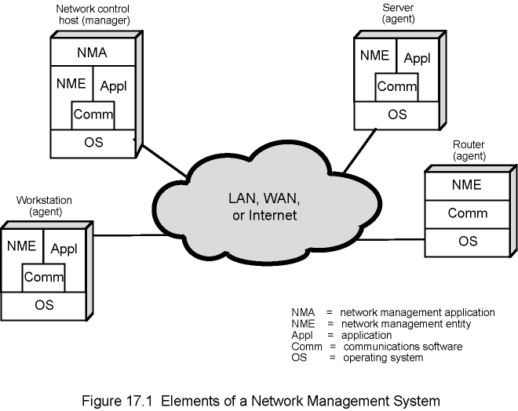
Figure 17.1 Elements of a Network Management System

Slide 18
Management Station
Stand alone system or part of shared system
Interface for human network manager
Set of management applications
Data analysis
Fault recovery
Interface to monitor and control network
Translate manager’s requirements into monitoring and control of remote elements
Data base of network management information extracted from managed entities

Slide 19
Management Agent
Hosts, bridges, hubs, routers equipped with agent software
Allow them to be managed from management station
Respond to requests for information
Respond to requests for action
Asynchronously supply unsolicited information

Slide 20
Management Information Base
MIB
Representation of network resources as objects
Each object a variable representing one aspect of managed object
MIB is collection of access points at agent for management of station
Objects standardized across class of system
Bridge, router etc.

Slide 21
Network Management Protocol
Link between management station and agent
TCP/IP uses SNMP
OSI uses Common Management Information Protocol (CMIP)
SNMPv2 (enhanced SNMP) for OSI and TCP/IP

Slide 22
Protocol Capabilities
Get
Set
Notify

Slide 23
Management Layout
May be centralized in simple network
May be distributed in large, complex network
Multiple management servers
Each manages pool of agents
Management may be delegated to intermediate manager

Slide 24
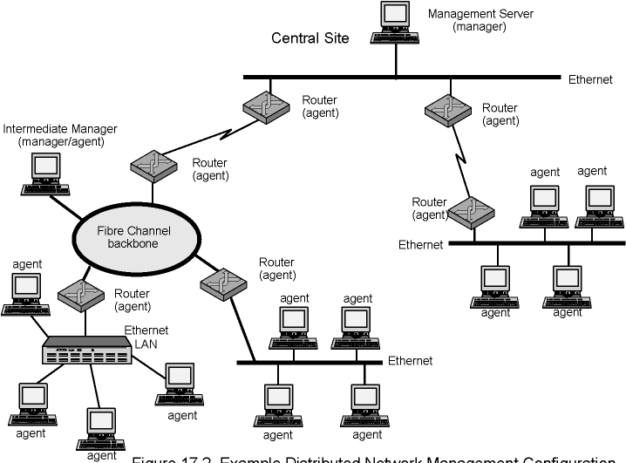
Figure 17.2 Example Distributed Network Management Configuration

Slide 25
Network Management Protocol Architecture
Application-level protocol
Part of TCP/IP protocol suite
Runs over UDP
From management station, three types of SNMP messages issued
GetRequest, GetNextRequest, and SetRequest
Port 161
Agent replies with GetResponse
Agent may issue trap message in response to event that affects MIB and underlying managed
Port 162

Slide 26
SNMP v1
August 1988 SNMP specification issued
Stand alone management stations and bridges, routers workstations etc supplied with agents
Defines limited, easily implemented MIB of scalar variables and two dimensional tables
Streamlined protocol
Limited functionality
Lack of security
SNMP v2 1993, revised 1996
RFC 1901-1908

Slide 27
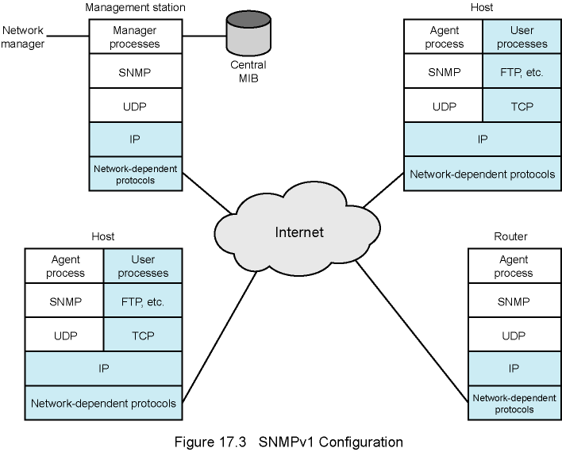
Figure 17.3 SNMPv1 Configuration

Slide 28
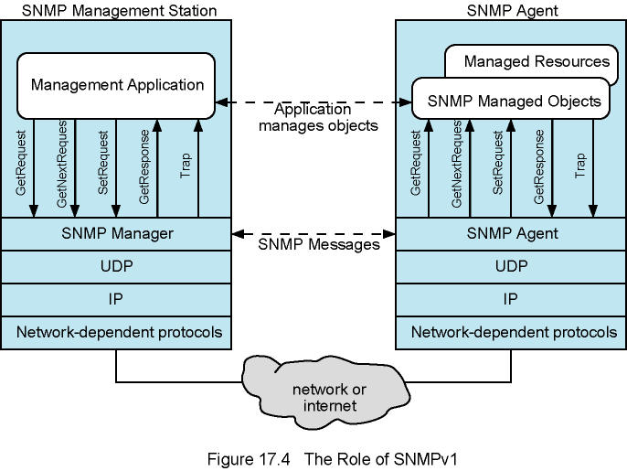
Figure 17.4 The Role of SNMPv1

Slide 29
SNMP v2 (1)
Framework on which network management applications can be built
e.g fault management, performance monitoring, accounting
Protocol used to exchange management information
Each player maintains local MIB
Structure defined in standard
At least one system responsible for management
Houses management applications

Slide 30
SNPM v2 (2)
Support central or distributed management
In distributes system, some elements operate as manager and agent
Exchanges use SNMP v2 protocol
Simple request/response protocol
Typically uses UDP
Ongoing reliable connection not required
Reduces management overhead

Slide 31
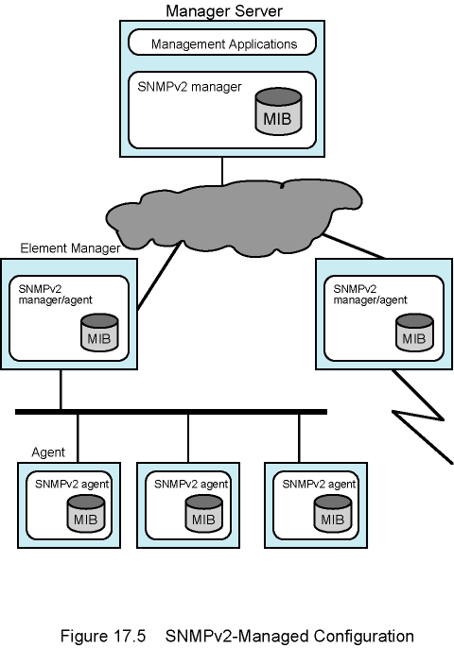
Figure 17.5 SNMPv2 Managed Configuration

Slide 32
Structure of Management Information
SMI
Defines general framework with which MIB defined and constructed
Identifies data types
How resources are represented and named
Encourages simplicity and extensibility
Scalars and two dimensional arrays of scalars (tables) only

Slide 33
Protocol Operation
Exchange of messages
Outer message header deals with security
Seven types of PDU

Slide 34
SNMP v3
Addresses security issues of SNMP v1/2
RFC 2570-2575
Proposed standard January 1998
Defines overall architecture and security capability
To be used with SNMP v2

Slide 35
SNMP v3 Services
Authentication
Part of User-Based Security (UBS)
Assures that message:
Came from identified source
Has not been altered
Has not been delayed or replayed
Privacy
Encrypted messages using DES
Access control
Can configure agents to provide a number of levels of access to MIB
Access to information
Limit operations

Slide 36
Assignment: 1 whole by twos
What are some of the important user requirements that should be considered on the following network management elements:
Accounting
Configuration
Performance
Security

